Slide 1
Bluetooth at Shure
A Brief Brief by Josh Heise
Notes:
Use this for Pro Audio Segments

Slide 2
Confidentiality Reminder
This is secret stuff! Don’t tell anyone!

Slide 3

Introduction
Bluetooth Classic
5.0 Announced, not really on the market
2Mbps
Most hardware is on 4.0
2.4Ghz
Point to Point (One sink, one source)
Bluetooth Low Energy
125Kbps
Can network
Many to many (mesh)

Slide 4
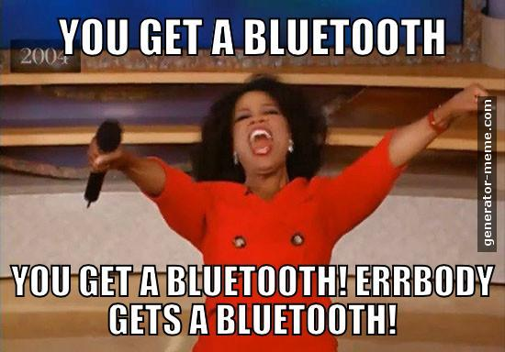
How Do We Use It
Bluetooth Low-Energy
Chronos
MXA
Taishin
Bluetooth Classic
Listening
TWS
BT1
Motiv

Slide 5
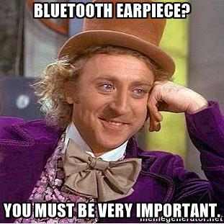
Bluetooth Classic with Audio
Packages information
Streams to device
Unpacks information
Plays it back
A2DP (Advanced Audio Distribution Profile)

Slide 6
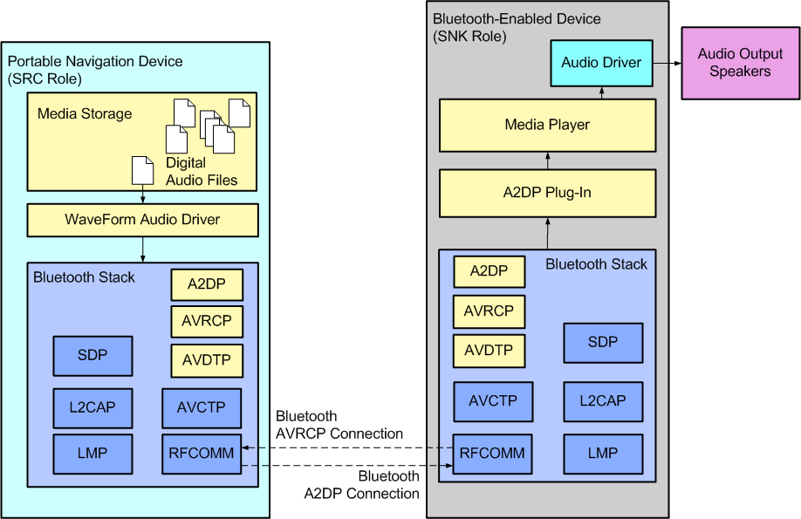
Audio Profiles
A2DP for audio streaming
Codecs
MP3, SBC (audio sub-band codec), AAC, aptX, aptxHD
AVRCP (Audio/Video Remote Control Profile)
HSP (Headest)
HFP (Hands-Free Phone)
Source vs Sink

Slide 7

THE REAL REASON WE’RE HERE
HARDWARE
CSR8675 (for listening)
Modules (BlueGiGa, BlueCreation)
All-in-one solutions
Testing
Audio Precision
Proprietary IDE

Slide 8
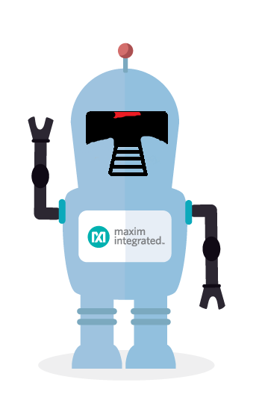
How Are We Better
Earphones
Duh.
DSP
120Mhz, 24-bit core, 32-bit instruction word, 12K x 32-bit program RAM
External flash available
Antenna
Current products have chip antennas
Custom antennas coming soon

Slide 9
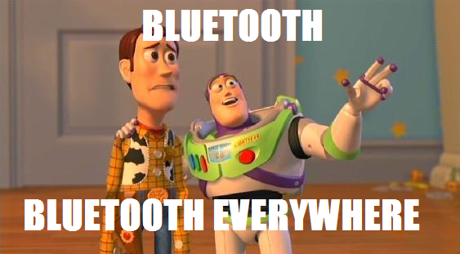
Where to next?
True Wireless Stereo
Firmware Update
Listening App
Expanding Markets

